Slide 1

Big Mountain Resort
Ticket Pricing Model

Slide 2
Agenda
The Problem
Our Recommendation
Modeling Results and Analysis

Slide 3
The Problem
Big Mountain currently uses a simplified ticket pricing strategy where prices are set at a premium above the average resorts in their segment
After spending upwards of $1.5 million on a new chair lift it is time to make some adjustments to ticket prices to maximize profit
GOAL – develop a data driven business strategy and pricing policy to implement in the upcoming ski season
Identify amenities that are of low value to customers where costs can be cut in a way that does not undermine ticket prices
Identify amenities that are of high value to customers and superior to comparable resorts that are not reflected in ticket prices which justify a price increase

Slide 4
Our Recommendation
Add A run
Increase vertical drop by 150 feet
Install an additional chair lift.

Slide 5
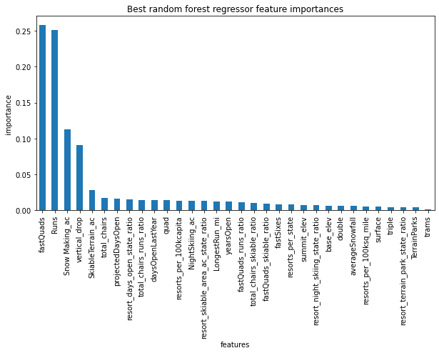
Results
Top four features driving pricing
fastQuads
Runs
Snow making capability
Vertical drop

Slide 6
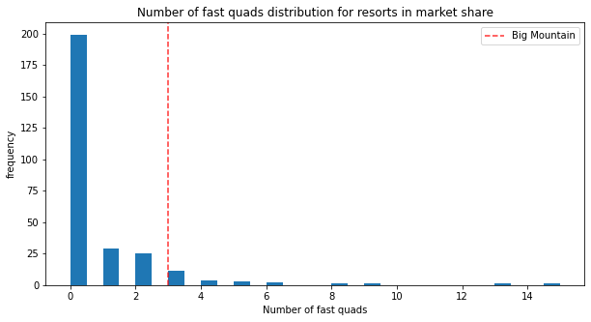
Fast Quads

Slide 7
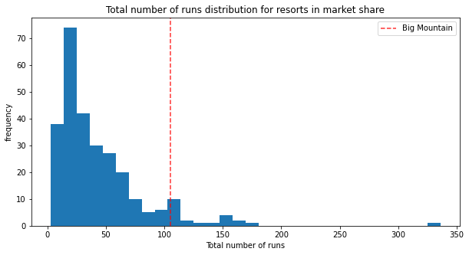
Total Runs

Slide 8
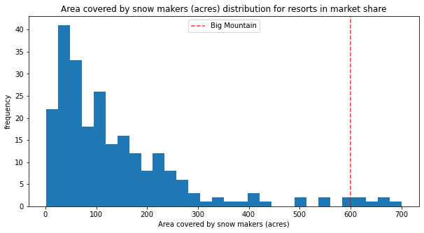
Area covered by Snow Makers

Slide 9
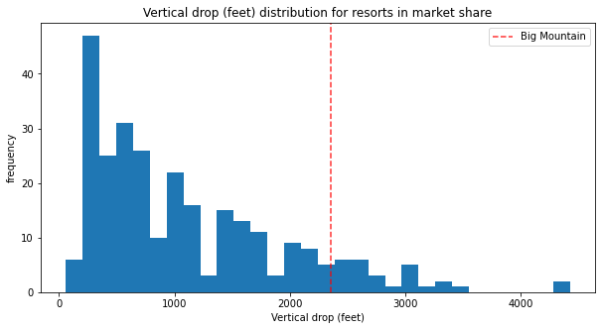
Vertical Drop

